Slide 1

Semantic Web, Open Data and NLP Oleksandr Krakovetskyi CEO, DevRain Solutions @msugvnua, alex.krakovetskiy@devrain.com https://www.facebook.com/alex.krakovetskiy

Slide 2
About
CEO of DevRain Solutions (software development company).
CTO DonorUA/Udonors.
Microsoft Regional Director.
Microsoft Most Valuable Professional.
Best Professional in Software Architecture (Ukrainian IT Award).
Ph.D. in Computer Science.
Community lead in Kyiv Smart City initiative, expert in Open Data.
Speaker and IT blogger.

Slide 3
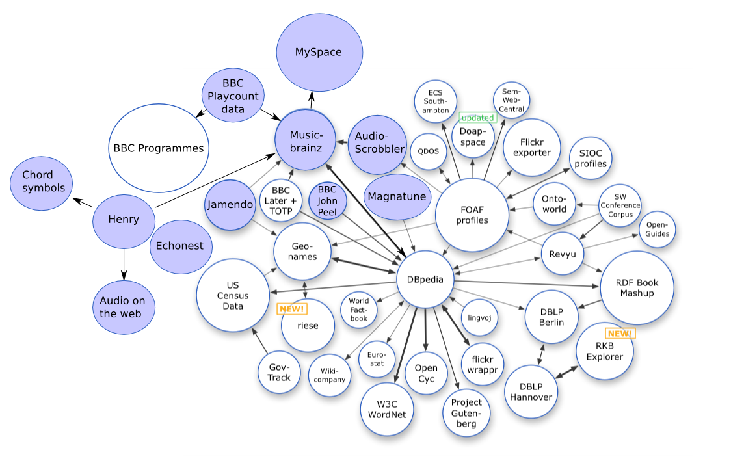
Open Data
Open data is the idea that some data should be freely available to everyone to use and republish as they wish, without restrictions from copyright, patents or other mechanisms of control.
https://en.wikipedia.org/wiki/Open_data

Slide 4

Data Sources
User behavior
Time series (weather, Forex, currencies)
IoT
Government
Science
Private companies data (e.g. Uber Movement)
Semantic Web

Slide 5
Reuters Corpora
As a service to the scientific community, Reuters is making available large quantities of Reuters News stories for research into natural language processing, information retrieval, machine learning, etc.
http://about.reuters.com/researchandstandards/corpus/

Slide 6
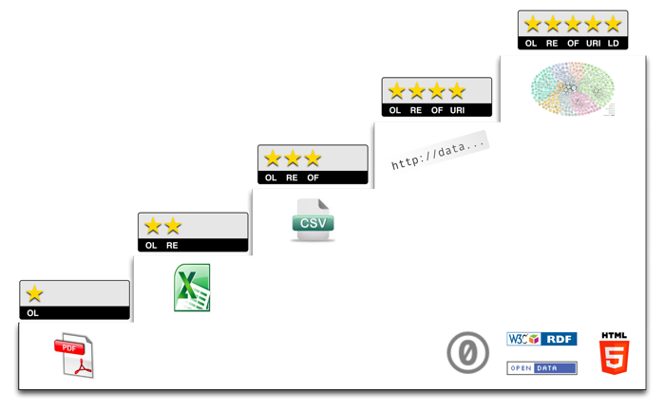
Classification of Open Data
Tim Berners-Lee, the inventor of the Web and Linked Data initiator, suggested a 5-star deployment scheme for Open Data. Here, we give examples for each step of the stars and explain costs and benefits that come along with it.
http://5stardata.info/

Slide 7
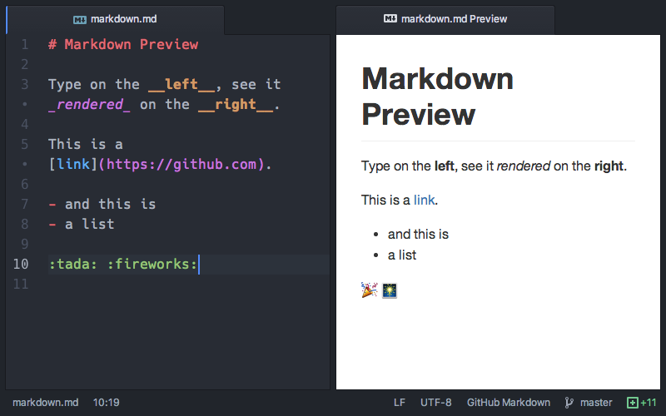
Open Data Formats
JSON
XML/RDF
TEXT/CSV/Markdown
HTML
PDF
Word

Slide 8

Semantic Web
The Semantic Web is an extension of the Web through standards by the World Wide Web Consortium (W3C). The standards promote common data formats and exchange protocols on the Web, most fundamentally the Resource Description Framework (RDF).

Slide 9
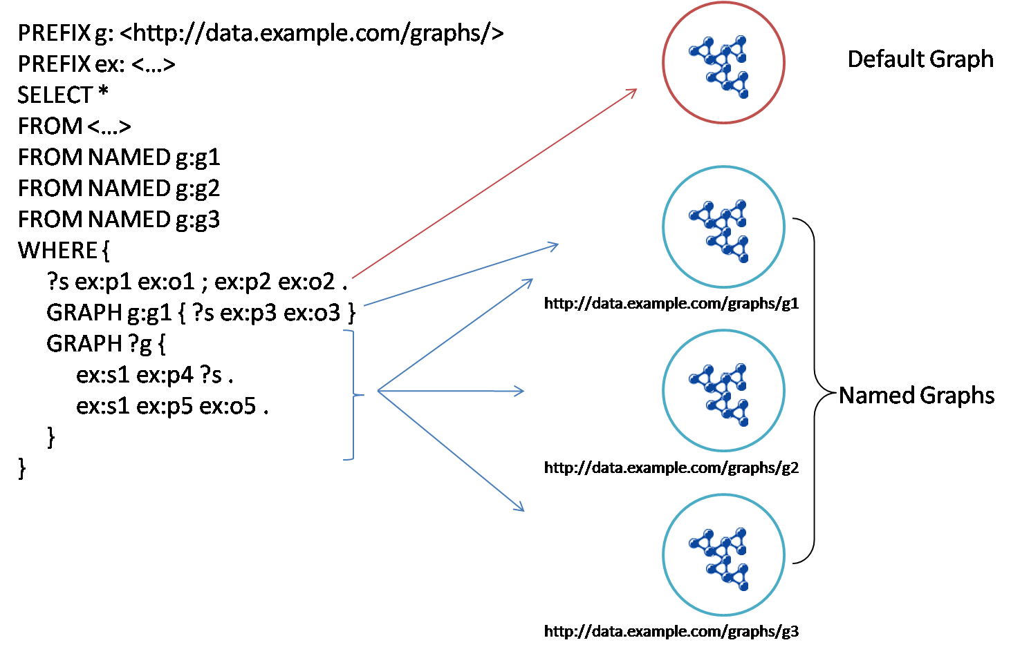
RDF & SPARQL
SPARQL is an RDF query language, that is, a semantic query language for databases, able to retrieve and manipulate data stored in Resource Description Framework (RDF) format.

Slide 10
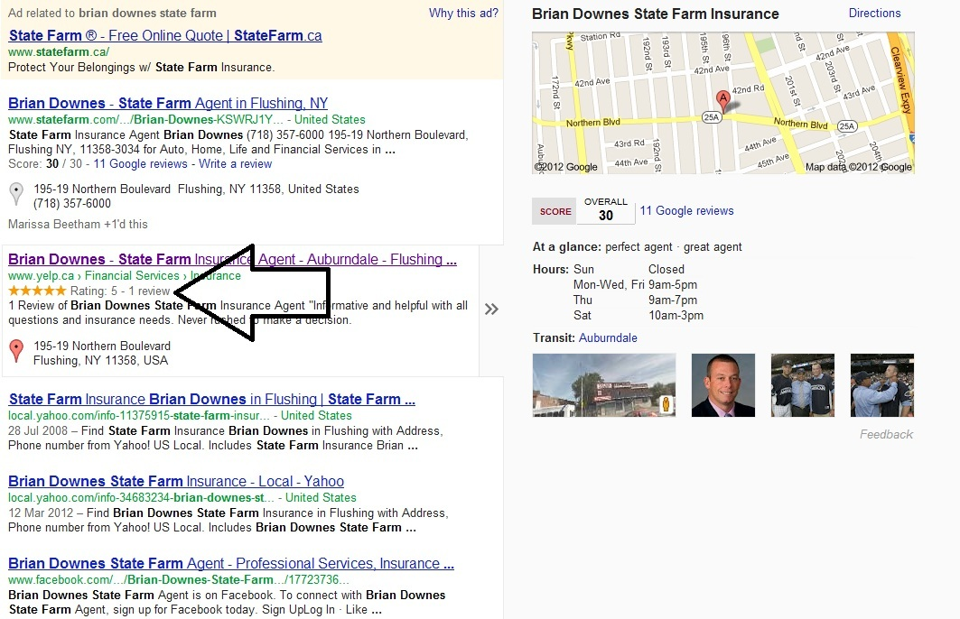
Microformats
Designed for humans first and machines second, microformats are a set of simple, open data formats built upon existing and widely adopted standards.
http://microformats.org/
Schema.org is a collaborative, community activity with a mission to create, maintain, and promote schemas for structured data on the Internet, on web pages, in email messages, and beyond.
http://schema.org/

Slide 11
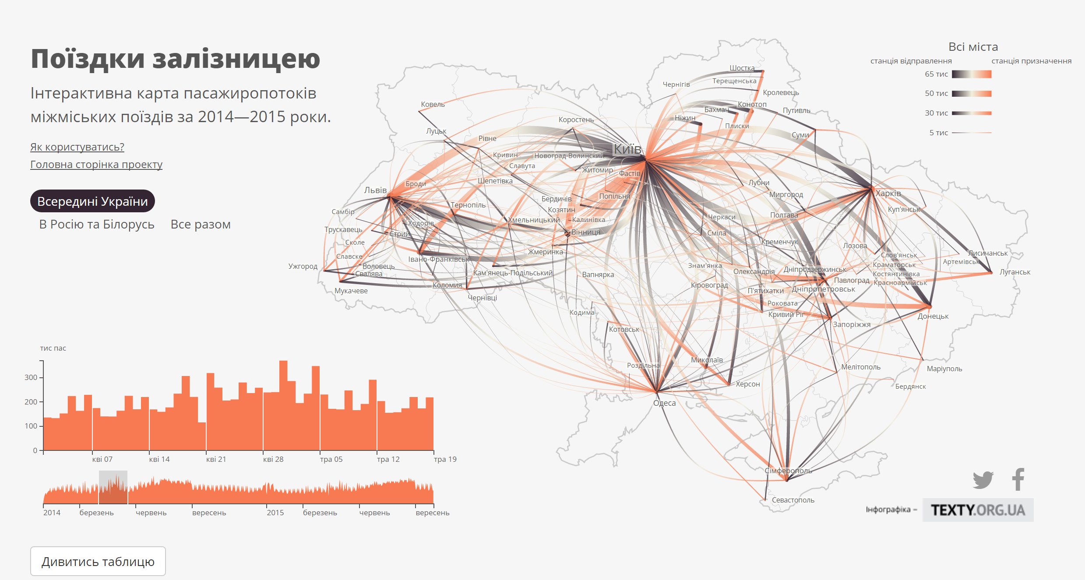
Відкриті дані

Slide 12
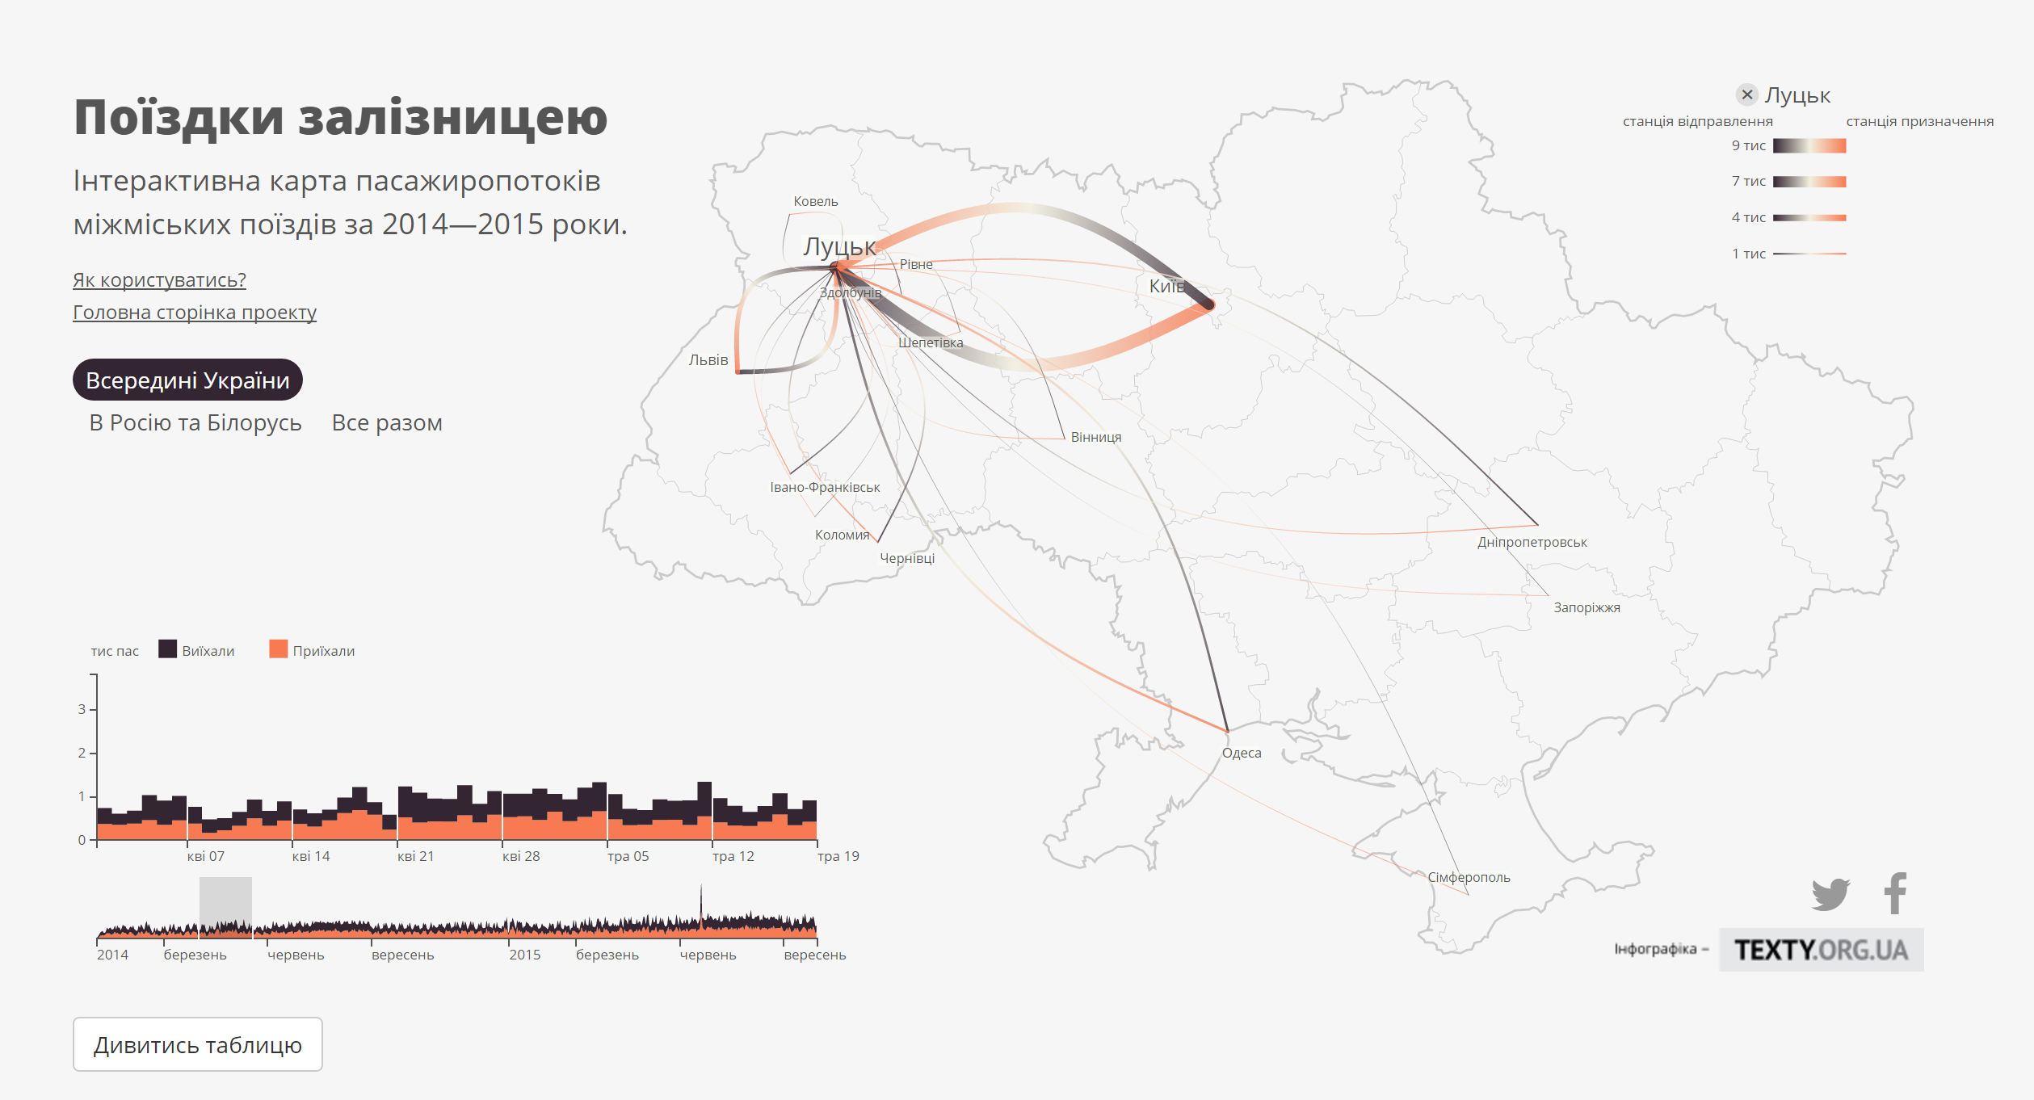
Відкриті дані

Slide 13
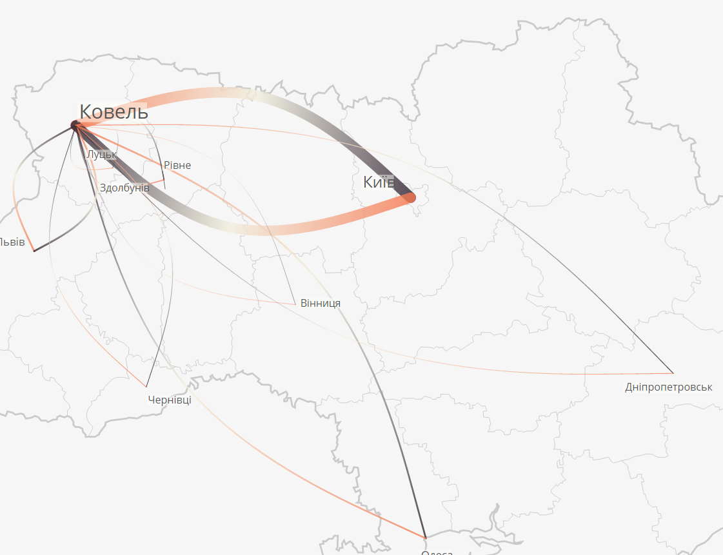
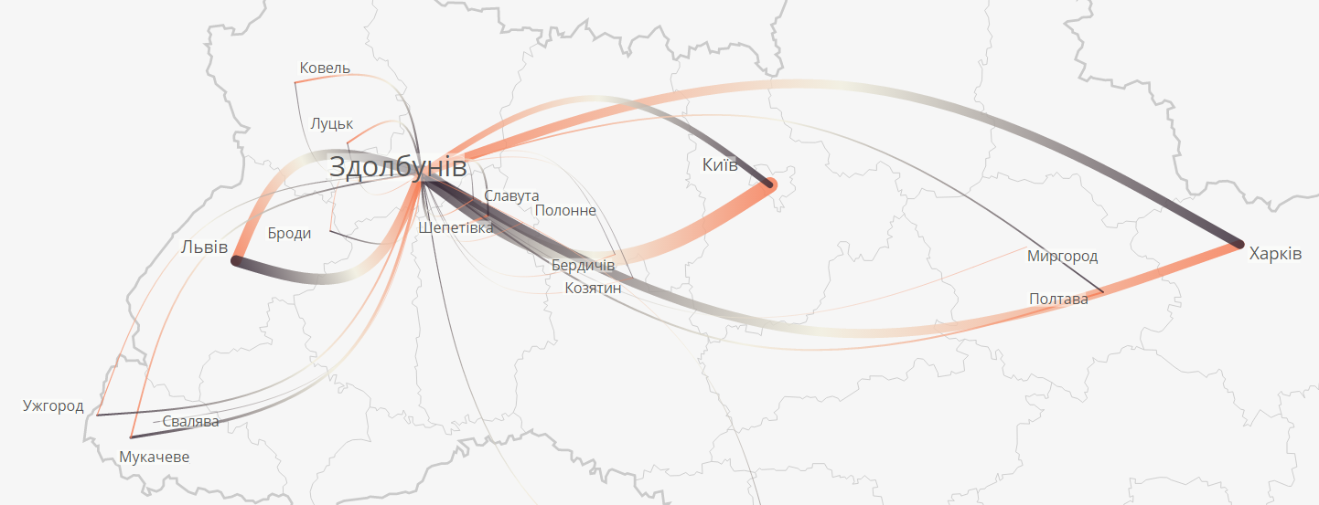
Відкриті дані

Slide 14
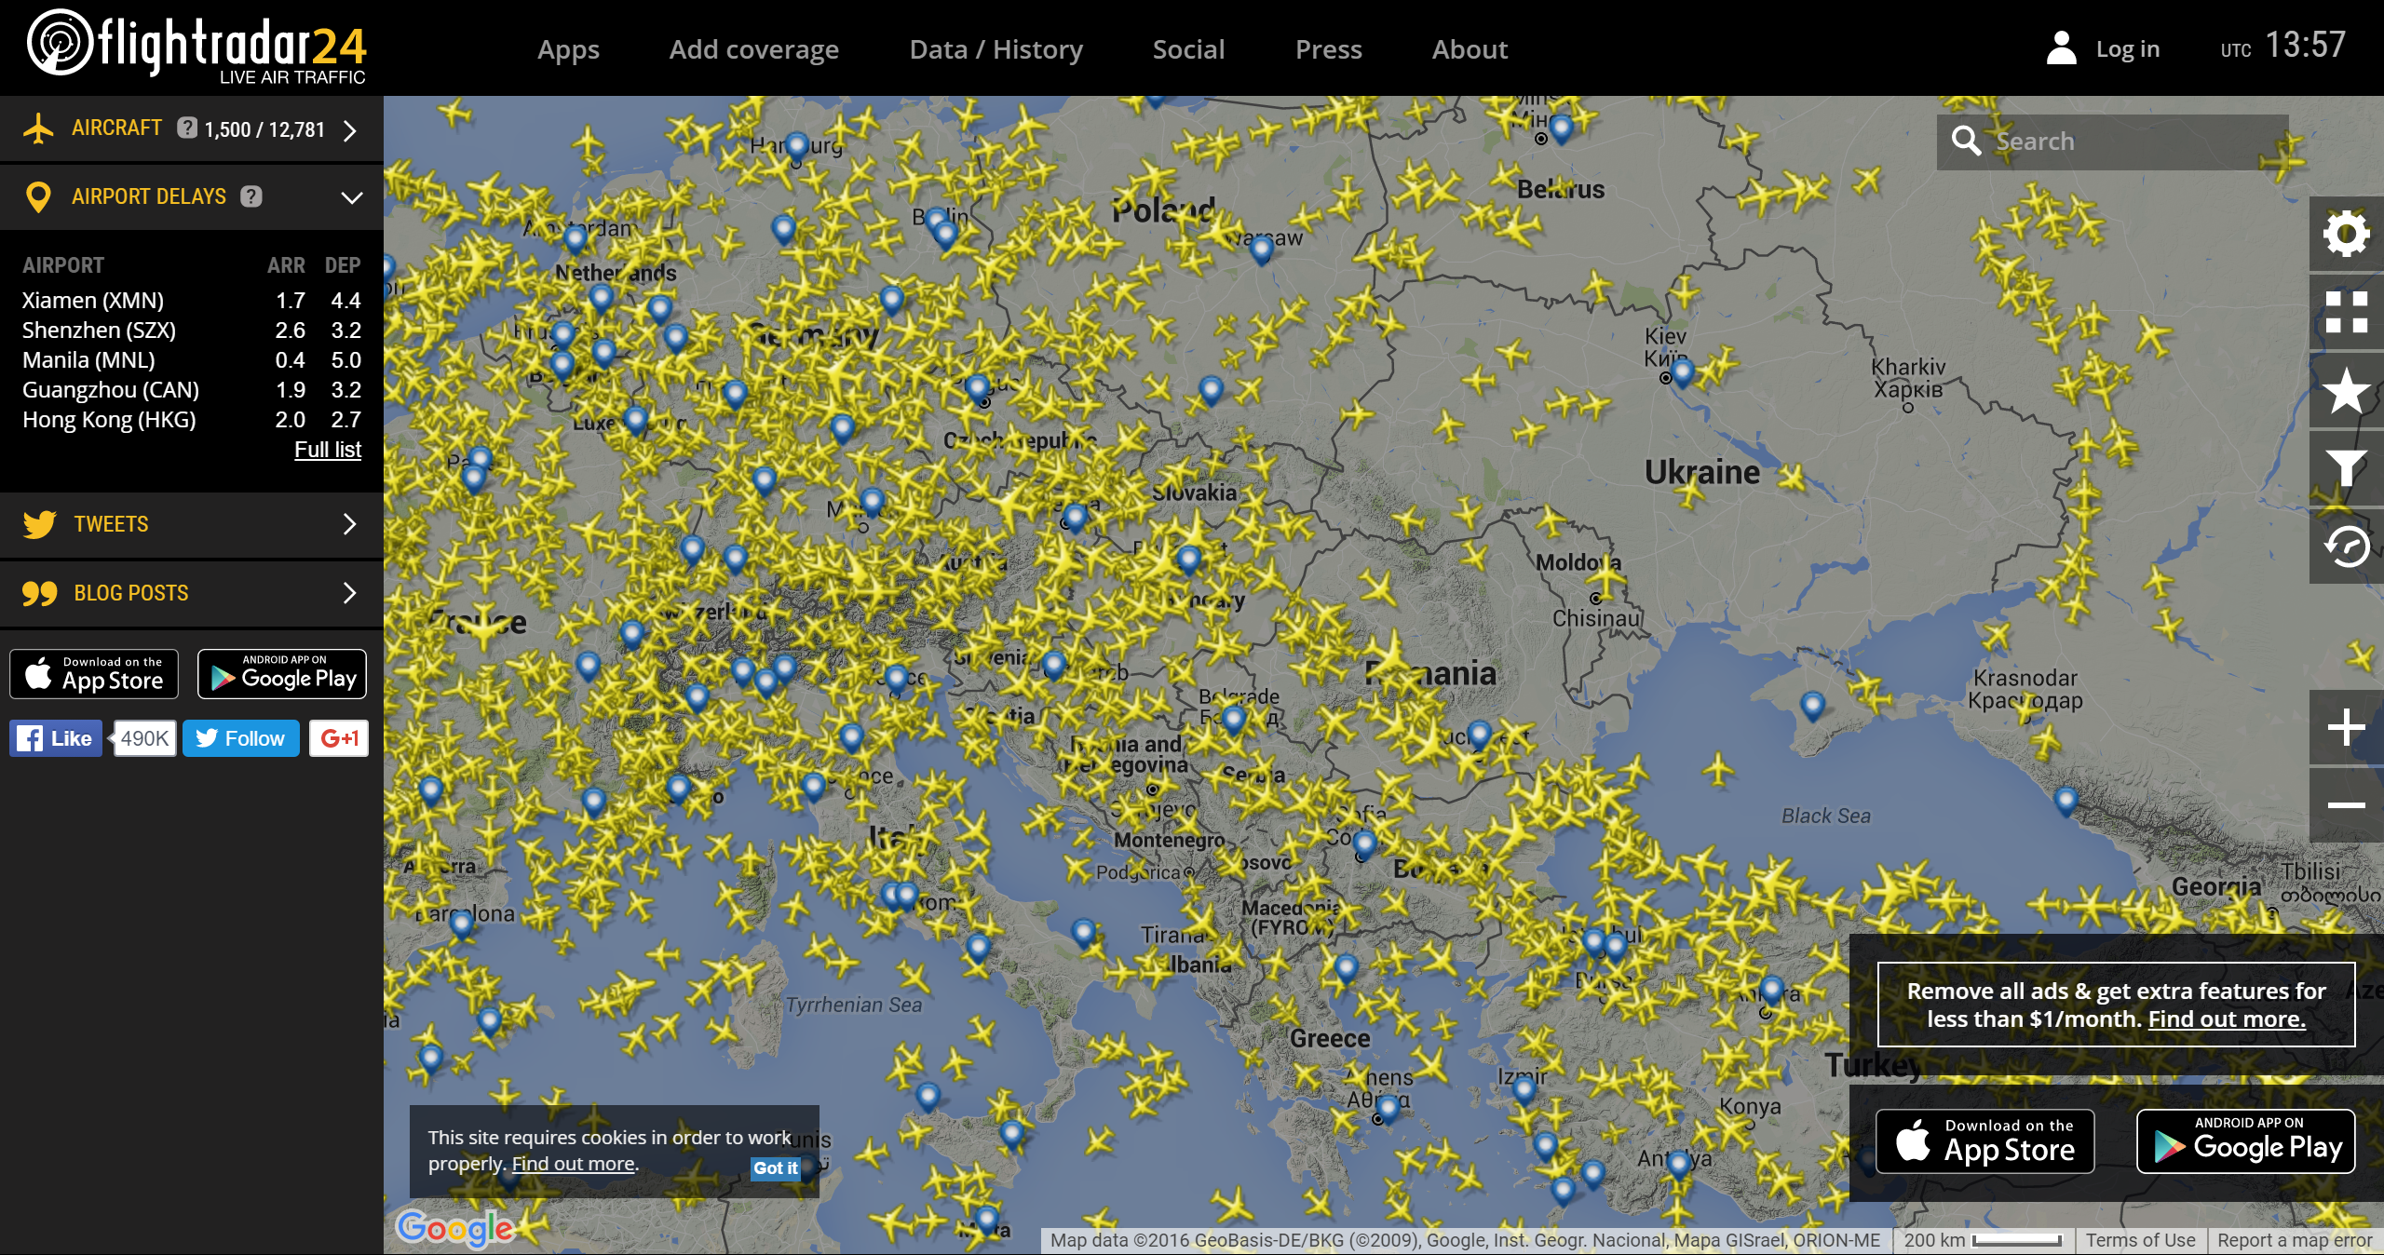
FlightRadar24
Повітряний трафік в реальному часі.
https://www.flightradar24.com/46.55,19.35/5

Slide 15
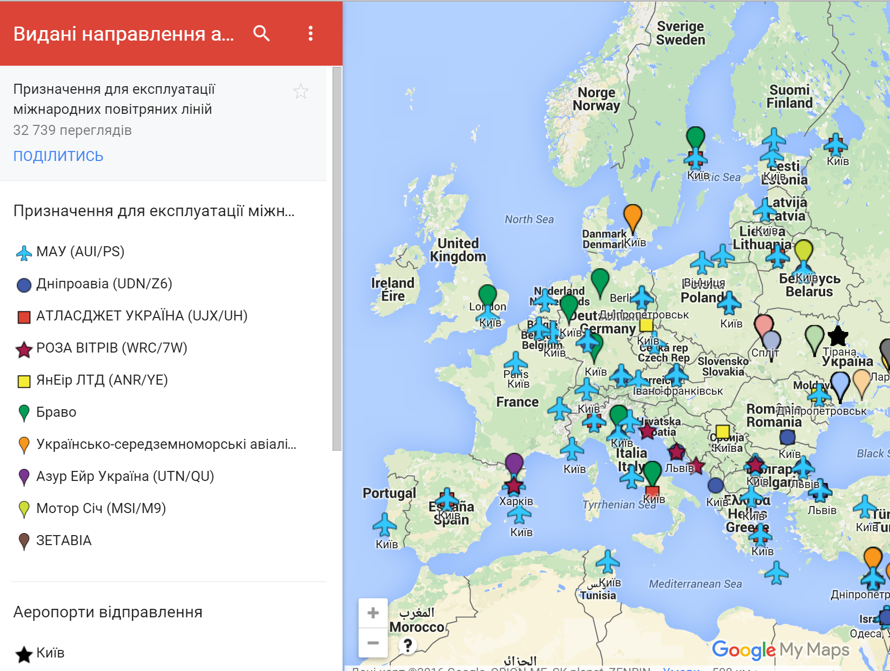
Видані направлення авіакомпаніям України
Призначення для експлуатації міжнародних повітряних ліній.
https://www.google.com/maps/d/viewer?mid=zQyzchol-IlQ.kqJvVjvXIY-s

Slide 16
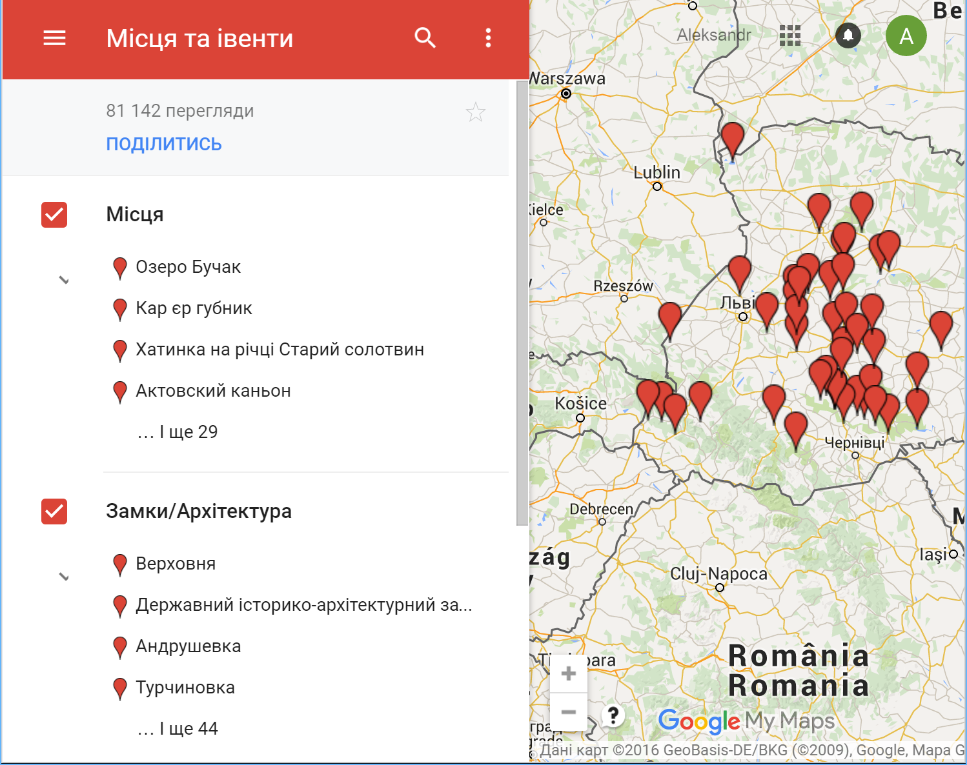
Місця та івенти
Туристичні місця України та події.
https://www.google.com/maps/d/viewer?mid=z8K60YZvAyvw.kjWTOyma-sGE

Slide 17


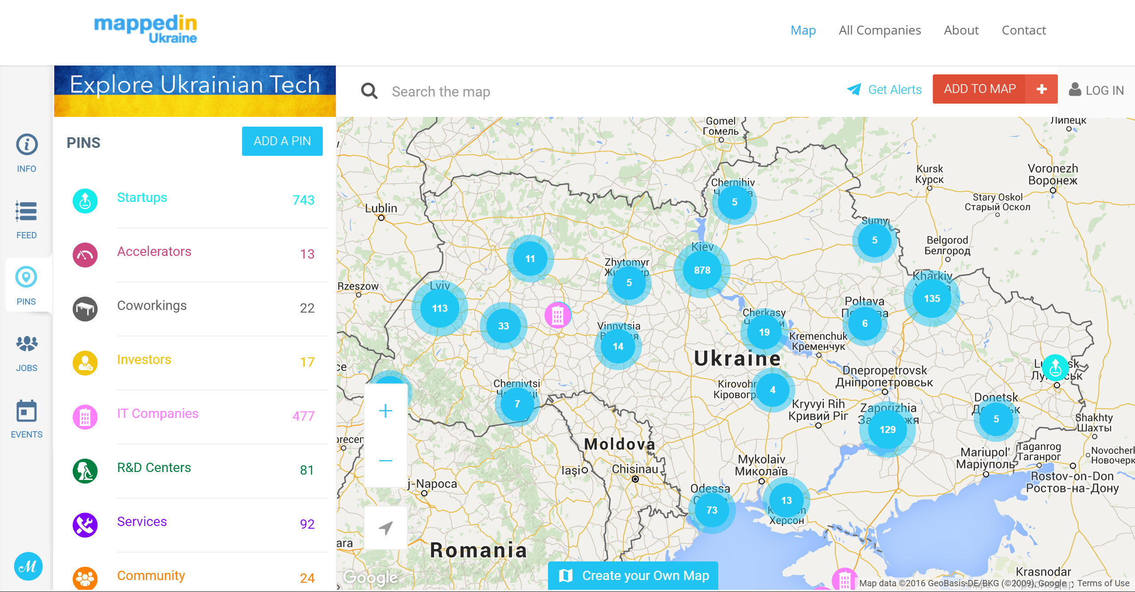
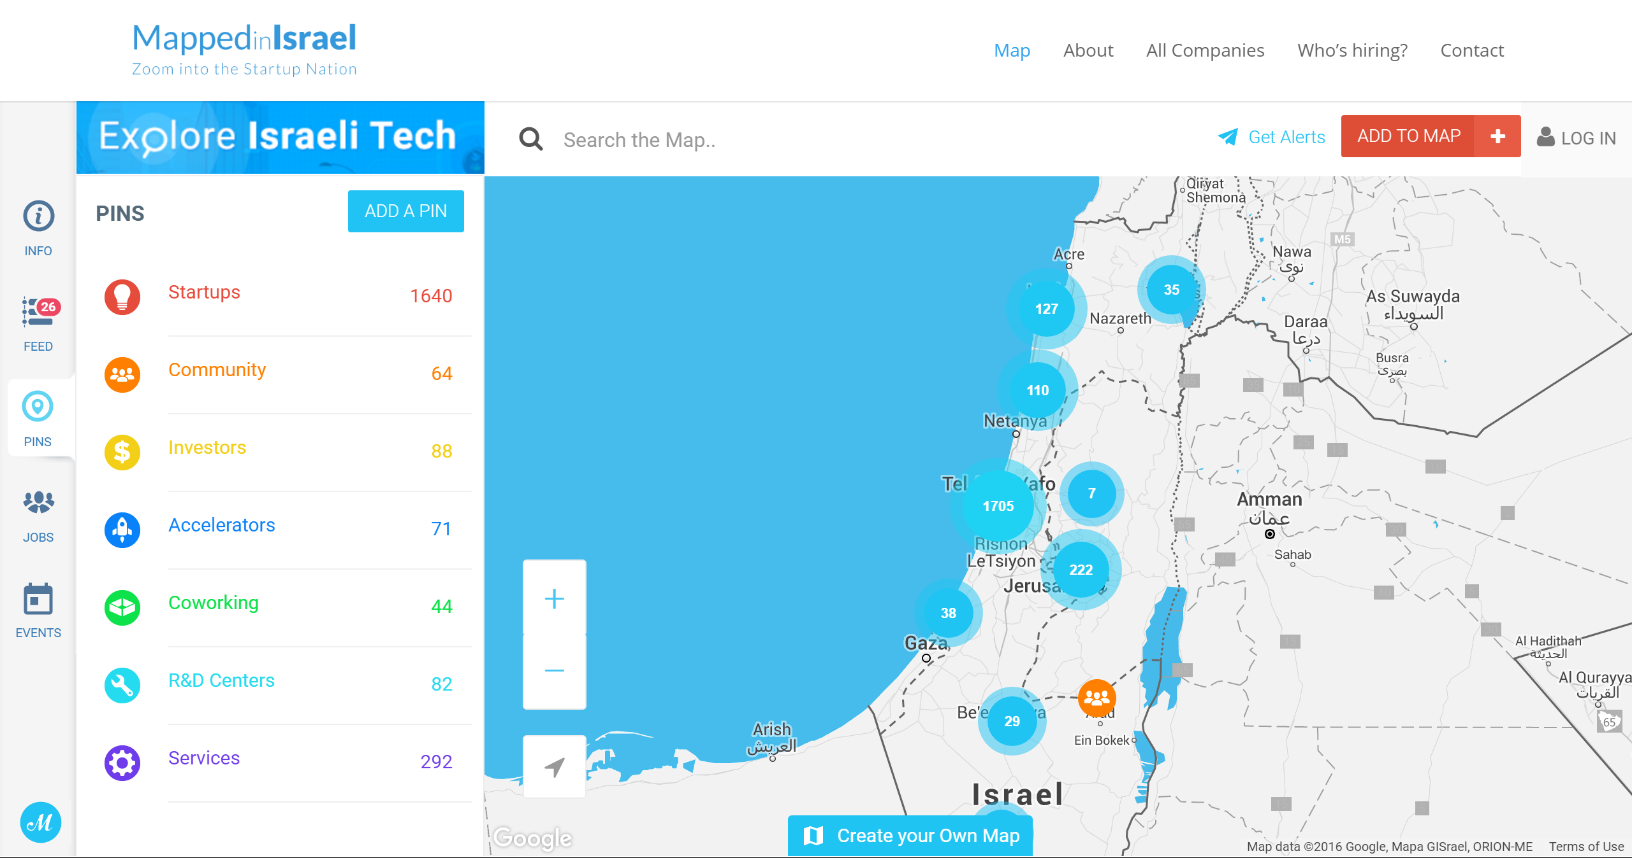

Slide 18
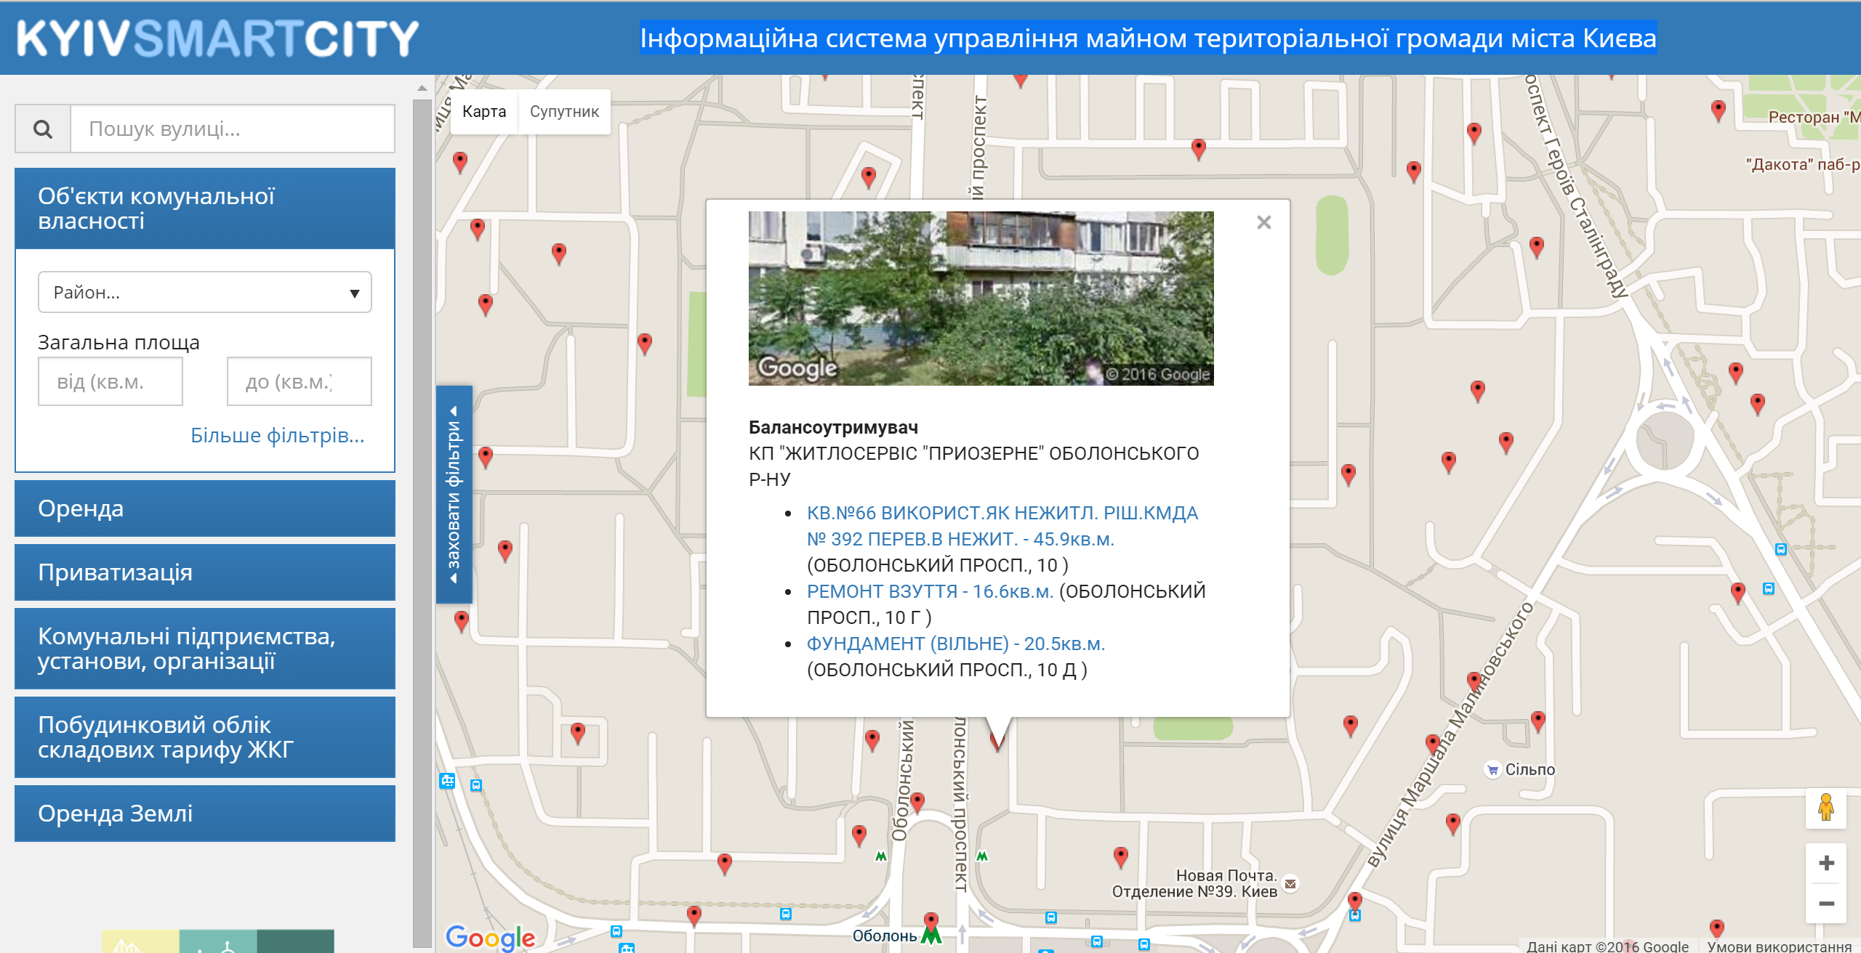
Інформаційна система управління майном територіальної громади міста Києва

Slide 19
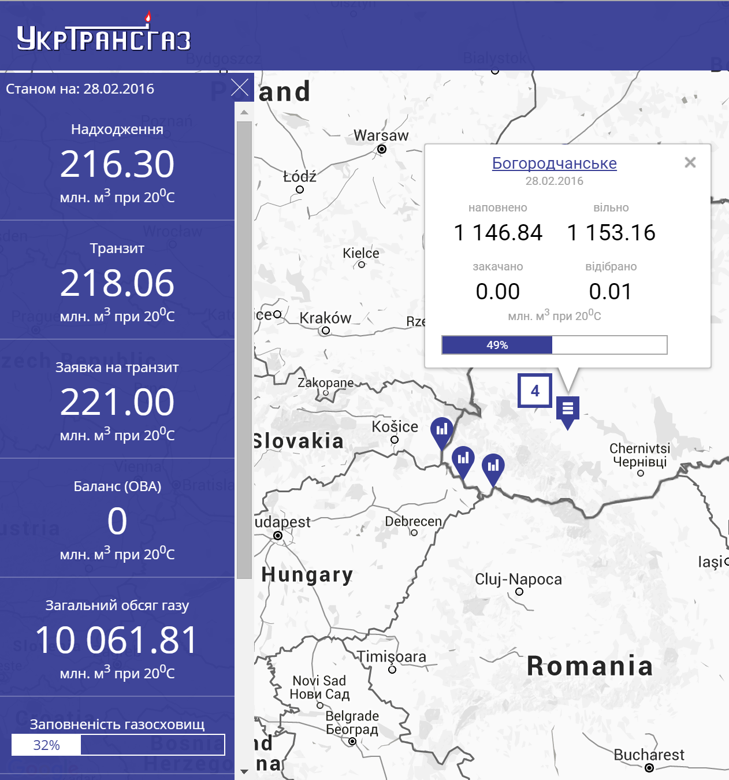
УкрТрансГаз
На карті показані трубопроводи через які газ потрапляє до України і через які залишає її. Показані сховища а також скільки газу закачано та викачано за добу і багато іншого.
http://utg.ua/live/

Slide 20
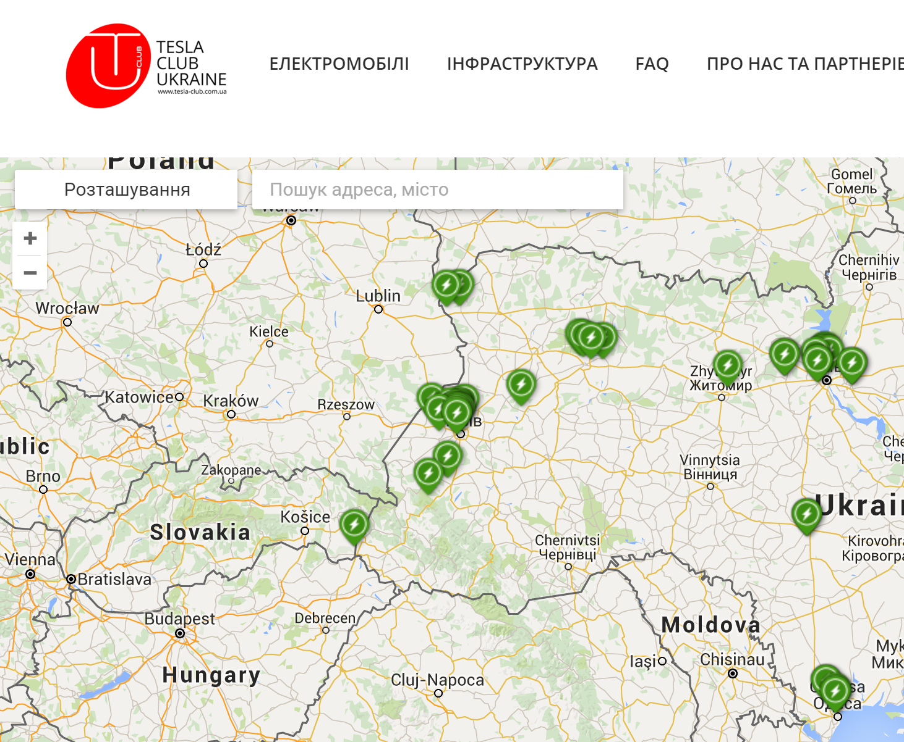
Tesla Club Ukraine
Мережа заправок для електромобілів.
http://tesla-club.com.ua/gmap

Slide 21
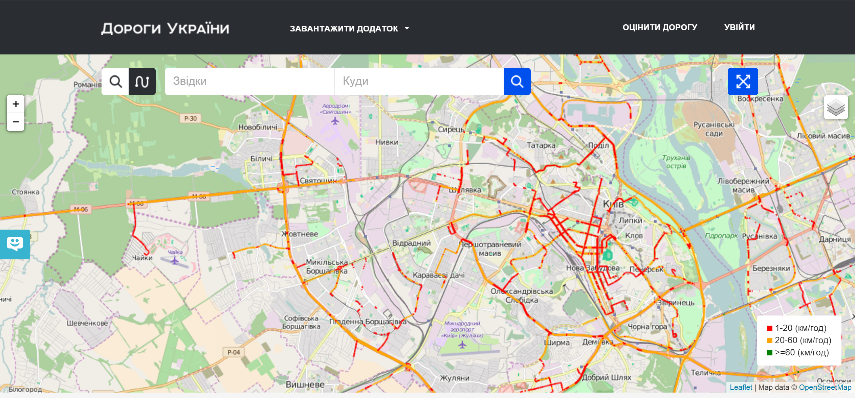
UA Roads
http://uaroads.com/

Slide 22
Natural Language Processing
Natural language processing is a field of computer science, artificial intelligence, and computational linguistics concerned with the interactions between computers and human (natural) languages.
Many challenges in NLP involve: natural language understanding, enabling computers to derive meaning from human or natural language input; and others involve natural language generation.

Slide 23
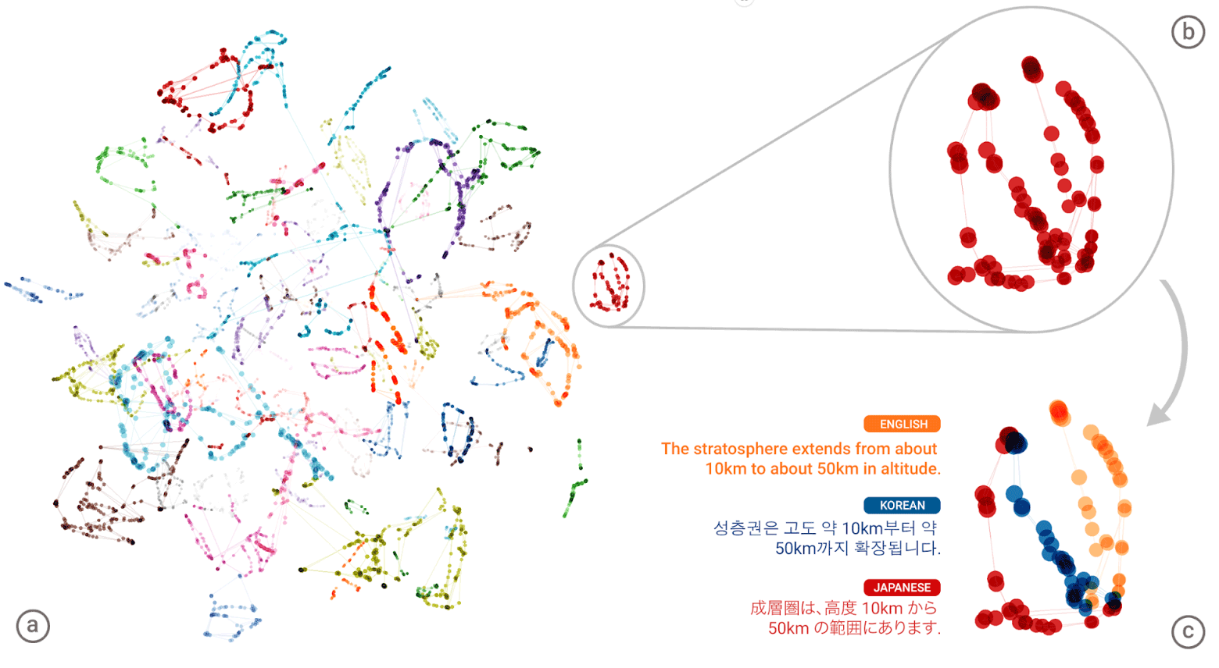
#4: GNMT
Google Neural Machine Translation (GNMT)
https://geektimes.ru/post/282976/

Slide 24
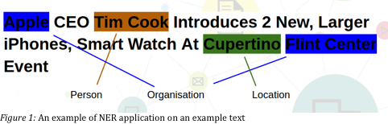
Named Entity Recognition
Subtask of information extraction that seeks to locate and classify named entities in text into pre-defined categories such as the names of persons, organizations, locations, expressions of times, quantities, monetary values, percentages, etc.

Slide 25
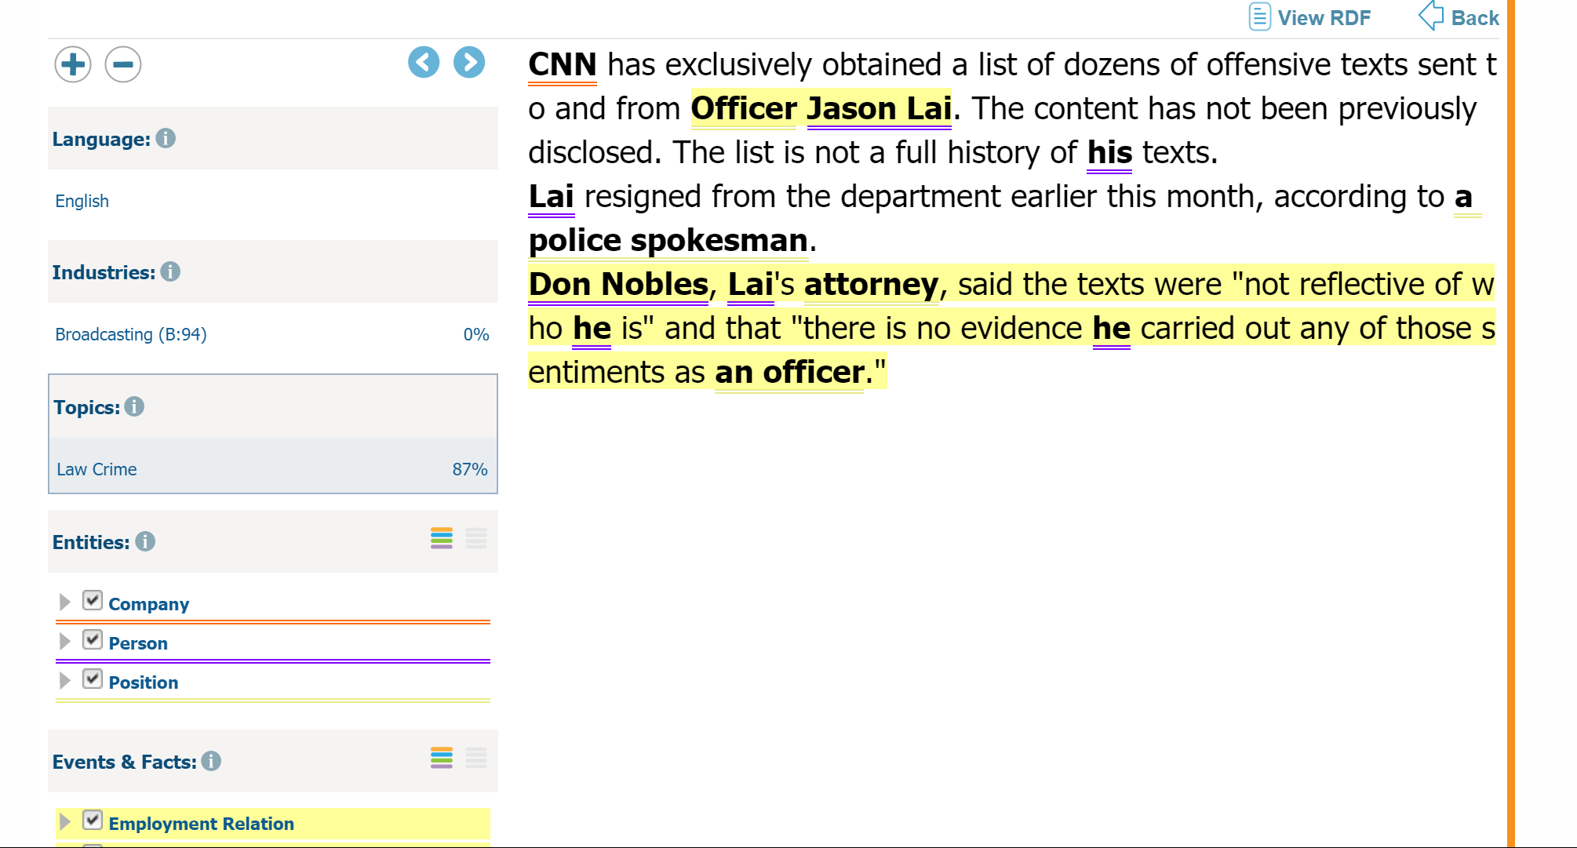
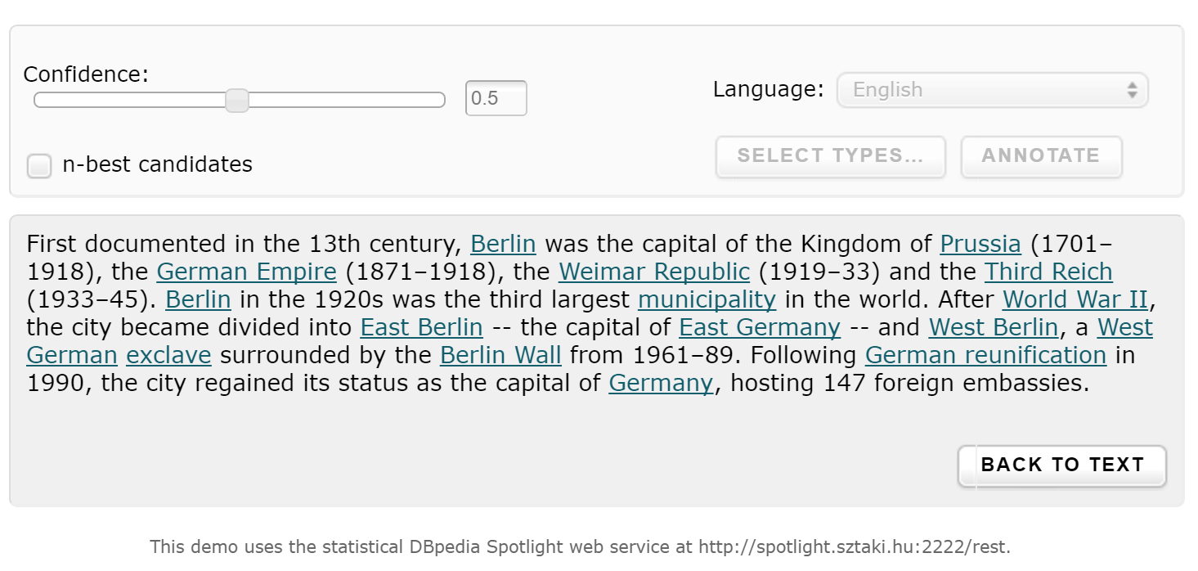
OpenCalais & Dbpedia Spotlight

Slide 26
NER Tools
http://msg.ai/
OpenCalais https://www.opencalais.com/opencalais-demo/
Dbpedia Spotlight
AlchemyAPI
BitextAPI https://www.bitext.com/text-analysis-api/
CogitoAPI http://www.cogitoapi.com/
Entitizer (Romanian, Russian, Bulgarian, Hungarian) http://klangoo.com/search.aspx
Magnet by Klangoo (40+ languages, including Klingon ...) http://klangoo.com/search.aspx
MeaningCloud http://www.meaningcloud.com/
Ingen.io https://www.quora.com/topic/Ingen-io
Rosette (many European, Middle Eastern and Asian langauges) https://developer.rosette.com/
Saplo https://www.quora.com/topic/Saplo-company
Semantria https://www.quora.com/topic/Semantria
Aylien.com http://aylien.com/
TextRazor https://www.textrazor.com/
Wolfram Alpha https://www.wolframalpha.com/
Microsoft Cognitive Services & Azure ML https://www.microsoft.com/cognitive-services/en-us/apis

Slide 27
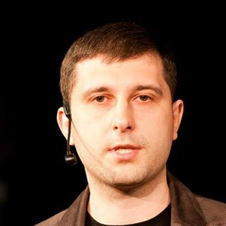
Q&A
Oleksandr Krakovetskyi
CEO DevRain Solutions
alex.krakovetskiy@devrain.com
@msugvnua
https://www.facebook.com/alex.krakovetskiy

